Slide 1
Day 14
Linux Device Driver Training
PROGRAM WITHOUT MAIN
Presented by,
Ganavi M
Ganavigowda512@gmail.com

Slide 2
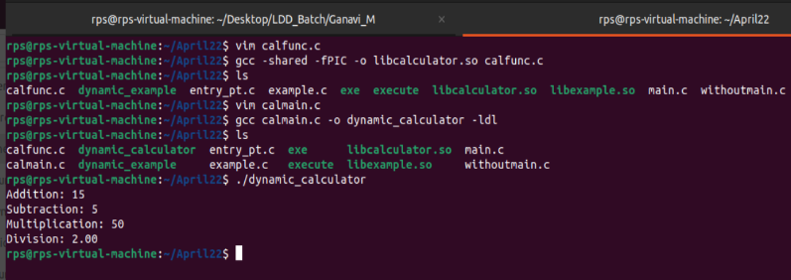
NO MAIN FUNCTION
PROGARM

Slide 3
gcc main.c -o dynamic_example -ldl:
gcc: This command invokes the GNU Compiler Collection, which is a compiler system supporting various programming languages.
main.c: This specifies the source file to be compiled, in this case, main.c.
-o dynamic_example: This option specifies the name of the output file. In this case, the output executable will be named dynamic_example.
-ldl: This option is used to link against the dynamic loading library (dl). It tells the linker to include the necessary symbols from the dynamic loading library, which provides functions for dynamically loading shared objects at runtime.
When you run this command, GCC compiles main.c into an executable named dynamic_example. The -ldl option ensures that the resulting executable is linked against the dynamic loading library, which is required for dynamically loading shared objects using functions like dlopen().
gcc -shared -fPIC -o libexample.so example.c:
-shared: This option tells GCC to produce a shared object file (.so). Shared objects contain code and data that can be used by multiple programs simultaneously.
-fPIC: This option stands for "Position-Independent Code". It tells GCC to generate position-independent code, which is required for shared objects. Position-independent code can be loaded and executed at any memory address without modification.
-o libexample.so: This specifies the output file name. In this case, the output shared object will be named libexample.so.
example.c: This specifies the source file to be compiled into the shared object, in this case, example.c.
When you run this command, GCC compiles example.c into a shared object file named libexample.so. This shared object will contain the hello_dynamic function that you defined in example.c. The -shared and -fPIC options ensure that the resulting shared object is suitable for dynamic linking.

Slide 4
Thank you

